Slide 1



Including People with Disabilities:
Public Health Workforce Competencies
Module 5
Competency 4: Implement and evaluate strategies to include people with disabilities in public health programs that promote health, prevent disease, and manage chronic and other health conditions
These modules were made possible by funding from the Association of Teachers of Maternal Child Health (ATMCH), and the Association of University Centers on Disabilities (AUCD).

Slide 2

Including People with Disabilities:
Public Health Workforce Competencies
Module 5
Competency 4: Implement and evaluate strategies to include people with disabilities in public health programs that promote health, prevent disease, and manage chronic and other health conditions
Competency 4: Implement and evaluate strategies to include people with disabilities in public health programs that promote health, prevent disease, and manage chronic and other health conditions
People with disabilities experience more chronic health problems than people without disabilities
Having access to health promotion, and preventative services is essential for people with disabilities for improved health outcomes
People with disabilities should be included in health promotion efforts, and disease prevention and management
It is not only the law, but it supports the commitment of public health professionals to ensure the reduction of health disparities
To understand the needs of people with disabilities, need to partner with them
This competency will help professionals to have foundational knowledge on program planning and health promotion that included people with disabilities

Slide 3
Including People with Disabilities:
Public Health Workforce Competencies
Module 5
Competency 4: Implement and evaluate strategies to include people with disabilities in public health programs that promote health, prevent disease, and manage chronic and other health conditions
Learning Objectives
1. Describe factors that affect health care access for people with disabilities.
2. Describe strategies to integrate people with disabilities into health promotion programs.
3. Identify emerging issues that impact people with disabilities.
4. Define how environment can impact health outcomes for people with disabilities.
5. Apply evaluation strategies (needs assessment, process evaluation, and program evaluation) that can be used to demonstrate impact for people with disabilities.

Slide 4
Including People with Disabilities:
Public Health Workforce Competencies
Module 5
Competency 4: Implement and evaluate strategies to include people with disabilities in public health programs that promote health, prevent disease, and manage chronic and other health conditions
Learning Objective 1
Describe factors that affect health care access for people with disabilities.
People with disabilities may experience barriers to health care access
Some of these barriers include: high cost of services, limited services, physical barriers, and a lack of skills and knowledge on the part of health care providers
Access to comprehensive, quality health care services is important for the achievement of health equity
Health care access is a twofold issue
People with disabilities also need to be health literate and advocate for themselves regarding barriers to health care and access
Health care professionals and public health professionals need to be aware of barriers to accessing health care for people with disabilities
Create an inclusive atmosphere for communication

Slide 5
Including People with Disabilities:
Public Health Workforce Competencies
Module 5
Competency 4: Implement and evaluate strategies to include people with disabilities in public health programs that promote health, prevent disease, and manage chronic and other health conditions
Example
With support from the Centers for Disease Control and Prevention (CDC), the Illinois Disability and Health Program collaborated with the Southern Illinois University School of Medicine in Springfield (SIU) to develop a disability awareness course for second-year medical students
The goal was to build a foundation of communication skills for better care and interaction with patients with disabilities
A panel presentation focused on the experiences of five people with disabilities
Each described their experiences accessing health care and offered tips on cultural sensitivity and disability etiquette
The program will continue to recruit additional health professional training programs and assist them in adding this important component to their curriculum
With awareness training available early in their careers, the next generation of medical providers will be able to reduce the barriers that people with disabilities currently face

Slide 6
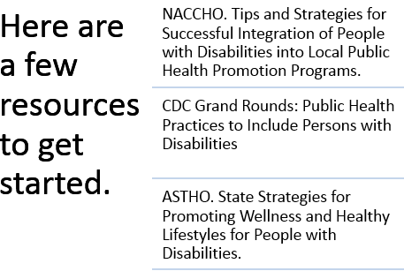
Including People with Disabilities:
Public Health Workforce Competencies
Module 5
Competency 4: Implement and evaluate strategies to include people with disabilities in public health programs that promote health, prevent disease, and manage chronic and other health conditions
Learning Objective 2
Describe strategies to integrate people with disabilities into health promotion programs.
Integrating people with disabilities into public health promotion campaigns is essential to decreasing health disparities
There are many resources for strategies to include people with disabilities in health promotion that are available for public health professionals to review
Being familiar with these strategies will aid in inclusion efforts

Slide 7
Including People with Disabilities:
Public Health Workforce Competencies
Module 5
Competency 4: Implement and evaluate strategies to include people with disabilities in public health programs that promote health, prevent disease, and manage chronic and other health conditions
Example
Montana’s Disability and Health Program has taken a multi-pronged approach in addressing health care barriers faced by women with disabilities in Montana
MDHP disseminated CDC’s Right to Know Campaign materials to share experiences some women have had trying to access women’s health services, and raise awareness about cancer and other health risks all women face
Every Woman Matters: A Montana Multi-media Event Highlighting the Importance of Breast Cancer Screening among Women with Physical Disabilities, which showcases local stories from women with disabilities to the community
Worked with mammography facilities throughout Montana to evaluate facility and customer service accessibility and create a Mammography Directory
Materials developed and disseminated strategically target multiple audiences to raise awareness and better incorporate people with disabilities into health promotion programs

Slide 8
Including People with Disabilities:
Public Health Workforce Competencies
Module 5
Competency 4: Implement and evaluate strategies to include people with disabilities in public health programs that promote health, prevent disease, and manage chronic and other health conditions
Learn more – Barriers to Health Care Access for People with Disabilities
People with disabilities encounter a range of barriers when they attempt to access health care including the following:
Prohibitive costs
Affordability of health services and transportation are two main reasons why people with disabilities do not receive needed health care in low-income countries
Limited availability of services
The lack of appropriate services for people with disabilities is a significant barrier to health care
Physical barriers
Uneven access to buildings (hospitals, health centers), inaccessible medical equipment, poor signage, narrow doorways, internal steps, inadequate bathroom facilities, and inaccessible parking areas create barriers to health care facilities.
Inadequate skills and knowledge of health workers
People with disabilities were more than twice as likely to report finding health care provider skills inadequate to meet their needs
Source: Disability and Health, World Health Organization (WHO)

Slide 9
Including People with Disabilities:
Public Health Workforce Competencies
Module 5
Competency 4: Implement and evaluate strategies to include people with disabilities in public health programs that promote health, prevent disease, and manage chronic and other health conditions
Learning Objective 3
Identify emerging issues that impact people with disabilities.
There are many issues to be aware of that impact the lives of people with disabilities. These emerging issues should be considered when planning public health programs.
Emerging Issues:
Housing
For many people with significant and long-term disabilities safety and accessibility in housing is an issue
As the population ages the rate of people with disabilities may increase, and so will the danger of falls and injury
For people with mobility issues, having housing that is accessible and safe is a daunting task
Also having communities that are safe and accessible is also a challenge

Slide 10
Including People with Disabilities:
Public Health Workforce Competencies
Module 5
Competency 4: Implement and evaluate strategies to include people with disabilities in public health programs that promote health, prevent disease, and manage chronic and other health conditions
Emerging Issues:
Emergency Preparedness
Mobility and other challenges for people with disabilities can add difficulty when emergencies arise
Emergency preparedness for people with disabilities that take into account challenges and issues is essential for public safety
Building Healthy Communities for Active Aging
As people age they may experience some form of disability. Also as people who have disabilities age their needs change as well
Older people with disabilities need sustainable environments free of hazards and accessibility challenges

Slide 11
Including People with Disabilities:
Public Health Workforce Competencies
Module 5
Competency 4: Implement and evaluate strategies to include people with disabilities in public health programs that promote health, prevent disease, and manage chronic and other health conditions
Emerging Issues:
Preventive Screening
People with disabilities have a greater incidence of chronic disease than people without disabilities
There is a greater need for people with disabilities to have access to preventative screenings for chronic health issues
Issues like access, and cost there may be barriers to preventative screening that public health professionals should be aware of to help decrease health disparities
Transportation
People with disabilities may have difficulty accessing transportation services
Transportation is vital for people with disabilities to access health care, employment and life in the community

Slide 12
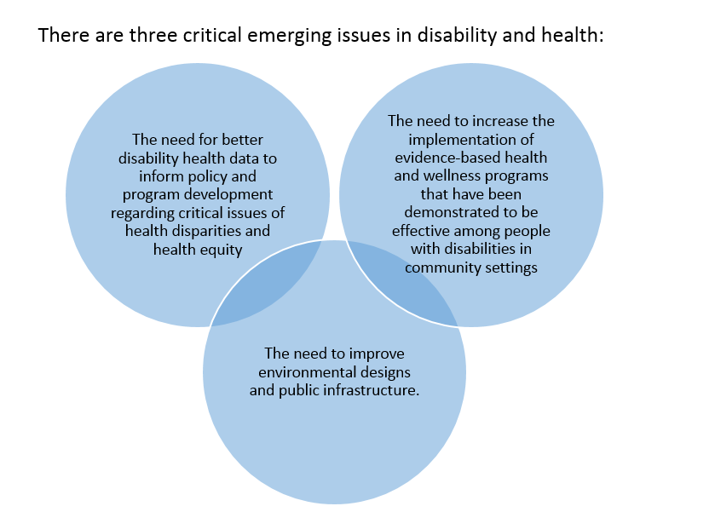
Including People with Disabilities:
Public Health Workforce Competencies
Module 5
Competency 4: Implement and evaluate strategies to include people with disabilities in public health programs that promote health, prevent disease, and manage chronic and other health conditions
Learn more - Emerging Issues in Disability and Health
Source: Healthy People 2020, Topics & Objectives, Disability and Health

Slide 13
Including People with Disabilities:
Public Health Workforce Competencies
Module 5
Competency 4: Implement and evaluate strategies to include people with disabilities in public health programs that promote health, prevent disease, and manage chronic and other health conditions
Examples
Housing
In Montana, one in four adults has a mobility limitation, and many require special equipment for mobility
Fewer than 20% of Montana homes are “visitable” and finding accessible housing is a major challenge for people with disabilities who want to live independently in the community
A lack of accessibility in a home can lead to greater possibility of falls, decreased independence, and isolation
Emergency Preparedness
In 2009, the Oregon Office on Disability and Health (OODH) developed the “Ready Now! Emergency Preparedness Toolkit”
“Ready Now!” encourages self-reliance, teaching people with disabilities how to prepare and care for themselves in case of an emergency
Participants learn to identify emergency situations, develop personal contact lists, and assemble “to-go bags” and “72-hour kits,” care for their pets and service animals during an emergency, develop evacuation plans, and update emergency preparedness plans

Slide 14
Including People with Disabilities:
Public Health Workforce Competencies
Module 5
Competency 4: Implement and evaluate strategies to include people with disabilities in public health programs that promote health, prevent disease, and manage chronic and other health conditions
Examples
Building Healthy Communities for Active Aging
The CDC Healthy Aging Research Network (HAN) brought together diverse communities and multi-disciplinary expertise from across the country to identify and address health promotion needs for healthy aging
Strong partnerships at local, regional and national levels were fundamental to HAN's successes.
Through these partnerships, HAN delivered on a mission to:
  Better understand the determinants of healthy aging in diverse populations and settings;
  Identify, develop and evaluate programs and policies that promote healthy aging; and
  Translate and disseminate research into effective and sustainable public health programs and policies throughout the nation
“Building Healthy Communities For Active Aging - National Recognition" Program supported by the U.S. Environmental Protection Agency (EPA) encourages and rewards existing and new communities to design senior friendly neighborhoods and environments

Slide 15
Including People with Disabilities:
Public Health Workforce Competencies
Module 5
Competency 4: Implement and evaluate strategies to include people with disabilities in public health programs that promote health, prevent disease, and manage chronic and other health conditions
Examples
Preventive Screening
The Right to Know Campaign is a breast cancer education project developed by the Centers for Disease Control and Prevention (CDC)
The campaign uses health promotion materials to target and encourage women with physical disabilities to get a mammogram
The Oregon Office on Disability and Health (OODH) takes this campaign one step further by promoting breast cancer screenings for women with ALL types of disabilities, including women with sensory and/or cognitive disabilities
They do this by ensuring that their activities, educational materials and trainings include information targeting women with all forms of developmental, cognitive and intellectual disabilities
In addition, OODH provides trainings and resources to health care professionals on how they can best serve the needs of women with various types of disabilities

Slide 16
Including People with Disabilities:
Public Health Workforce Competencies
Module 5
Competency 4: Implement and evaluate strategies to include people with disabilities in public health programs that promote health, prevent disease, and manage chronic and other health conditions
Examples
Transportation
In Gainesville, Florida, the fixed-route bus system is the city’s primary form of public transportation
Although individuals with disabilities are offered a reduced fare, or are able to ride free of charge (if they have an ADA identification card), many have to rely on expensive and limited paratransit services instead of riding the bus
In a partnership between the Center for Independent Living of North Center Florida and the University of Florida’s College of Public Health students used a Bus Stop Checklist published by Easter Seals Project Action
Of the 254 bus stops assessed, only 15 (5.9%) met the criteria necessary to be deemed accessible
The findings were presented at a community meeting and again during a City Commission meeting, which prompted a motion carried that required the Regional Transit System to submit a report on the current ADA compliance of their bus stops

Slide 17
Including People with Disabilities:
Public Health Workforce Competencies
Module 5
Competency 4: Implement and evaluate strategies to include people with disabilities in public health programs that promote health, prevent disease, and manage chronic and other health conditions
Learning Objective 4
Define how environment can impact health outcomes for people with disabilities.
There is a direct relationship between how the environment where people live, work and recreate in affects their physical and mental health outcomes
Environment is a social and physical determinant of health
Poor health outcomes can be made worse because of the interaction between people with disabilities with their social and physical environments
Physical determinates of health related to environments include built environments
Social determinates of health related to environments include availability of resources, employment, and healthy foods, exposure to crime and violence, social supports, transportation options, and socioeconomic conditions
A “visitable” home is one which has at least one zero-step entrance, a bathroom on the main floor, and hallways and doorways wide enough to accommodate a wheelchair

Slide 18
Including People with Disabilities:
Public Health Workforce Competencies
Module 5
Competency 4: Implement and evaluate strategies to include people with disabilities in public health programs that promote health, prevent disease, and manage chronic and other health conditions
Example
Concrete Change is an international coalition organization formed in Atlanta that advocates for structural and legislative shifts that promote basic home access
Information and resources on making all homes accessible to everyone
Includes information for builders, contractors, realtors, architects and others
The site includes information about visitability, a movement to change home construction practices so that virtually all new homes offer a few specific features to make them easier for people with disabilities to live in or visit
Concrete Change worked with the city of Atlanta to pass the nation's first visitability law, which required that all public housing be accessible
Atlanta now has more than 500 single family homes with visitability features

Slide 19
Including People with Disabilities:
Public Health Workforce Competencies
Module 5
Competency 4: Implement and evaluate strategies to include people with disabilities in public health programs that promote health, prevent disease, and manage chronic and other health conditions
Learning Objective 5
Apply evaluation strategies (needs assessment, process evaluation, and program evaluation) that can be used to demonstrate impact for people with disabilities.
People with disabilities are more likely to experience chronic health problems and health disparities
Having an understanding of program and process evaluations will increase the capacity of public health professionals to create and manage programs targeted at reducing health disparities for people with disabilities

Slide 20
Including People with Disabilities:
Public Health Workforce Competencies
Module 5
Competency 4: Implement and evaluate strategies to include people with disabilities in public health programs that promote health, prevent disease, and manage chronic and other health conditions
Example
The Community Health Inclusion Index (CHII), is an evaluation tool for improving inclusion of people with disabilities in community health initiatives
The information collected through the CHII can be used by public health professionals and community programs to understand the needs in their communities and develop new initiatives for improving healthy, active living among people with disabilities
A recent study on the CHII was co-authored by the Institute on Disability and Human Development at the University of Illinois at Chicago; the University of Alabama at Birmingham/Lakeshore Foundation Research Collaborative; and the National Center on Birth Defects and Developmental Disabilities (NCBDDD) at the Centers for Disease Control and Prevention (CDC)

Slide 21
Including People with Disabilities:
Public Health Workforce Competencies
Module 5
Competency 4: Implement and evaluate strategies to include people with disabilities in public health programs that promote health, prevent disease, and manage chronic and other health conditions
Example
Special Olympics Healthy Athletes program has provided more than 1.6 million free health screenings in more than 130 countries to people with intellectual disabilities
The Special Olympics Healthy Athletes® program offers health services and information to athletes in dire need
In the process, Special Olympics has become the largest global public health organization dedicated to serving people with intellectual disabilities
Data collection is incorporated at every phase of planning and implementation, which is then aggregated to demonstrate progress towards the goal of reduced health disparities for people with disabilities
Data on the health of athletes collected through free health screenings is used to demonstrate need for the program’s medical services provided by program volunteers
Both program participants and program volunteers report on their satisfaction and increase in knowledge during and after the program, and provide feedback on program success and worth
Findings from these combined strategies are used to educate policymakers, expand research and programming, and promote greater awareness of health disparities and needs

