Slide 1
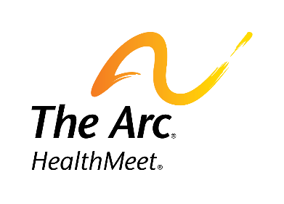
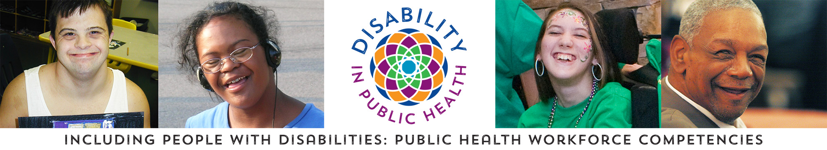
The Arc HealthMeet® Training
Webinar for Public Health Professionals

Slide 2

The Arc HealthMeet® Training
Including People with Disabilities: Public Health Workforce
Competencies
In this webinar we will cover:
Definitions of intellectual and other disabilities, and the chronic and secondary health issues of people with disabilities
Information on health disparities that people with disabilities may face and emerging issues for this population
An overview of the Competencies, learning objectives and strategies for implementation
How to implement the Competencies within your own discipline

Slide 3

The Arc HealthMeet® Training
Including People with Disabilities: Public Health Workforce
Competencies
This content is adapted from content from the Including People with Disabilities: Public Health Workforce Competencies (www.disabilityinpublichealth.org)
Funding for these training modules was provided to the Association of University Centers on Disabilities (AUCD) from The Arc of the United States

Slide 4
Including People with Disabilities: Public Health Workforce
Competencies
HealthMeet® is a project of The Arc and is supported by Grant/Cooperative Agreement Number 5U59DD000993-03 from the Centers for Disease Control and Prevention for a grant award of $1,000,000
HealthMeet® leverages its national network of more than 650 Chapters, national disability organizations, public health systems, health professionals, university systems, and other key stakeholders to reduce health disparities and increase the longevity and quality of life for people with intellectual disability (ID) by providing free community-based health assessments and individualized recommendations for follow-up care
Assessments focus on general health and body composition, vision, hearing, oral health, foot care, respiratory health, mental health and lifestyle factors such as diet and nutrition, physical activity, substance use, and access to health care
HealthMeet® also provides training and education for individuals, their families, direct service professionals, medical providers, and medical and nursing students and raises public awareness of health issues that impact people with intellectual disability across the country
Find out more about HealthMeet's services and why it's needed.

Slide 5

The Arc HealthMeet® Training
Including People with Disabilities: Public Health Workforce Competencies
Including People with Disabilities: Public Health Workforce Competencies
About the Project
The Including People with Disabilities: Public Health Workforce Competencies was a multiyear AUCD project Cooperative Agreement Number, 5 U38 OT 000140 – 03 and 5 UO1 DD 000231-05 funded by the Centers for Disease Control and Prevention
The Competencies were developed by a national committee comprised of disability and public health experts
The Competencies provide foundational knowledge about the relationship between public health programs and health outcomes among people with disabilities, and are primarily designed for professionals already working in the public health field but can also be used for public health workforce training
For more information on the project visit: www.disabilityinpublichealth.org

Slide 6
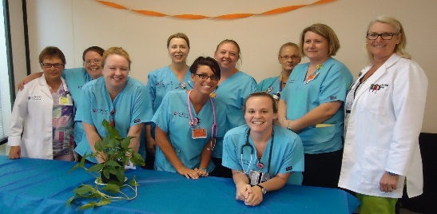
The Arc HealthMeet® Training
Including People with Disabilities: Public Health Workforce
Competencies
About the Competencies
Compared to people without disabilities, people with disabilities are at a higher risk for poor health outcomes such as hypertension, obesity, falls-related injuries, and depression
Knowledge about the health status and public health needs of people with disabilities is essential for addressing these and other health disparities
However, most public health training programs do not include curriculum on people with disabilities and methods for including them in core public health efforts
Notes:
After bullet 1
African Americans and Hispanic/Latinos typically experience disability at a higher rate than Whites, experience even greater health disparities, and report poorer health in comparison to the general population (Assuring Health Equity for Minority Persons, OMH, 2011)
After bullet 3
There is a clear need for public health efforts to reduce health disparities among people with disabilities
This may be achieved by building a stronger public health workforce skilled in ways to include people with disabilities in all public health efforts

Slide 7
The Arc HealthMeet® Training
The Arc HealthMeet® Training
Including People with Disabilities: Public Health Workforce
Competencies
About the Competencies
Including People with Disabilities: Public Health Workforce Competencies outlines recent advances in knowledge and practice skills that public health professionals need to include people with disabilities in the core public health functions - Assessment, Policy Development and Assurance
The Competencies provide strategies to meet the competencies and real examples of how people with disabilities can be successfully included in public health activities
These Competencies align with and compliment existing broad public health competencies
Notes:
Bullet 2 -including those developed by the Association of Schools and Programs of Public Health, Masters in Public Health Core Competencies; Public Health Accreditation Board; Public Health Foundation Core Competencies for Public Health Professionals, Council on Linkages Between Public Health and Academia, and the 10 Essential Public Health Services
Bullet 3 - ,In addition, they foster workforce capacity-building priorities such as the Healthy People 2020, Disability and Health Objective DH-3 ((Increase the proportion of U.S. MPH-granting public health schools and programs that offer graduate-level studies in disability and health)

Slide 8

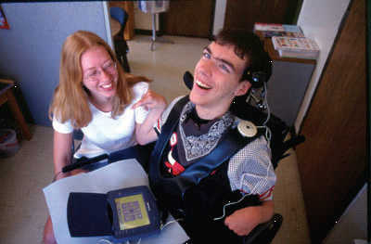
The Arc HealthMeet® Training
The Arc HealthMeet® Training
Including People with Disabilities: Public Health Workforce
Competencies
Introduction
Significance of Disability and Public Health
People with disabilities are a significant portion of the community and one of the most marginalized groups in our society
Racial/ethnic minorities with ID and other disabilities may experience additional disparities
It is important for public health professionals to understand disability, ID and the related often preventable health conditions related to the is population
Notes:
They are our co-workers, neighbors, family members, friends, and community members
People with intellectual disability (ID) are one of the most marginalized groups in our society, as they often have extremely limited access to education, employment, and financial resources
Racial/ethnic minorities with ID and other disabilities may experience additional disparities in health, prejudice, economic barriers, and difficulty accessing health care as a result of their disability

Slide 9
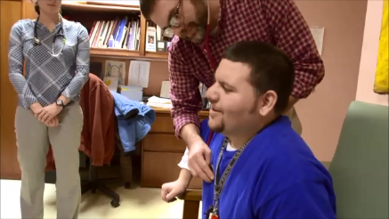
The Arc HealthMeet® Training
Including People with Disabilities: Public Health Workforce
Competencies
Definitions of Disability
“Disability” can be used in different contexts by health professionals, disability advocates, or others
There is no one single definition
Disability is not just a health problem
Disabilities can be physical, communicative, cognitive, or be caused by mental illness
Notes:
Americans with Disabilities Act (ADA) disability definition:
“physical or mental impairment that substantially limits one or more major life activities, a person who has a history or record of such an impairment, or a person who is perceived by others as having such an impairment”
Social Security Administration (SSA) disability definition: “you must not be able to engage in any substantial gainful activity (SGA) because of a medically-determinable physical or mental impairment(s):
That is expected to result in death, or
That has lasted or is expected to last for a continuous period of at least 12 months.

Slide 10
The Arc HealthMeet® Training
Including People with Disabilities: Public Health Workforce
Competencies
Definitions of Disability
Intellectual disability can be defined as a below-average cognitive ability with three (3) characteristics:
  Intelligent quotient (or I.Q.) is between 70-75 or below
  Significant limitations in adaptive behaviors (the ability to adapt and carry on everyday life activities such as self-care, socializing, communicating, etc.)
  The onset of the disability occurs before age 18
Sometimes intellectual disability is also referred to as developmental disability (DD)
The major differences between ID and DD are in the:
  age of onset
  severity of limitations, and
  fact that a person with a developmental disability definition may or may not have a low I.Q.
Notes:
DD is a broader term that includes ASD (autism spectrum disorders), epilepsy, cerebral palsy, developmental delay, fetal alcohol syndrome (or FASD) and other disorders that occur during the developmental period (birth to age 18)
Some people with intellectual disability will also meet the definition of developmental disability
It is estimated that at least half do not meet the requirements for the developmental disability definition

Slide 11
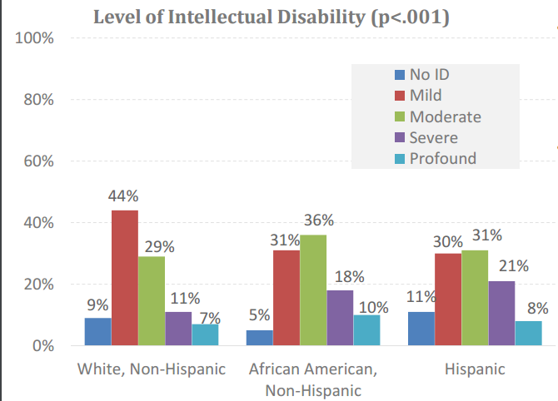
The Arc HealthMeet® Training
The Arc HealthMeet® Training
Including People with Disabilities: Public Health Workforce
Competencies
Prevalence of Adults with ID in the U.S.
Data show that over 56.7 million Americans have a disability
Between one 1% - 3% of Americans have intellectual disability (ID)
Source: National Core Indicators (NCI), 2013
Notes:
African American and Hispanics are more likely than Whites to be diagnosed with moderate, severe, or profound ID
31 % of African Americans have mild ID, and 36% have moderate ID
30% of Hispanics have mild ID, and 36% have moderate ID

Slide 12
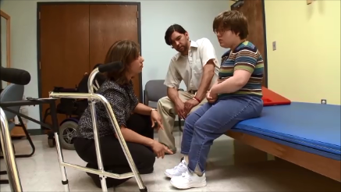
The Arc HealthMeet® Training
The Arc HealthMeet® Training
Including People with Disabilities: Public Health Workforce
Competencies
Adults with ID in the U.S.
There are many causes of intellectual disability
The impact of having an intellectual disability varies considerably, just as the range of abilities varies considerably among all people
Aside from the public health issues that most racial/ethnic minorities face, minorities with disabilities experience additional disparities in health, prejudice, economic barriers, and difficulties accessing care
Notes:
Factors that contribute to ID may be physical, genetic and/or social
Down syndrome, Fragile X syndrome and Fetal Alcohol Spectrum Disorder (FASD) are commonly associated with ID
As adults, some people are able to lead independent lives in the community without paid supports
A small percentage will have serious, lifelong limitations in functioning

Slide 13
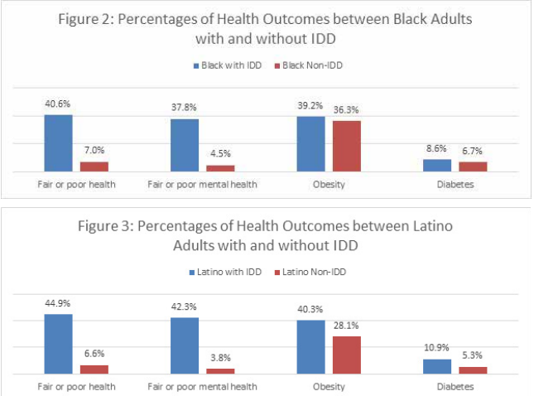
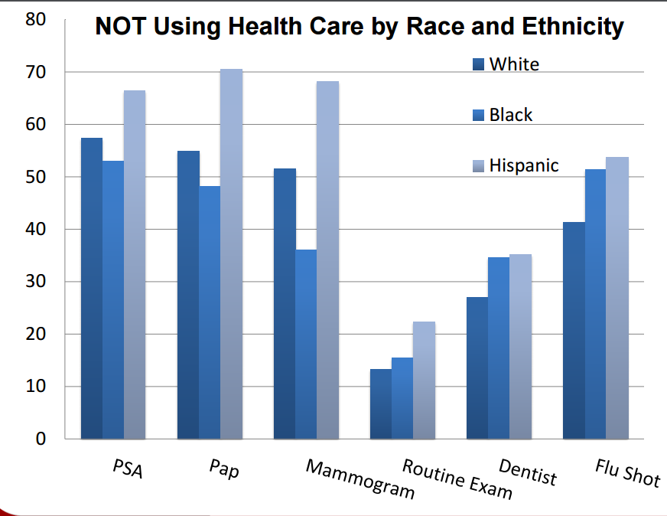
The Arc HealthMeet® Training
The Arc HealthMeet® Training
Including People with Disabilities: Public Health Workforce
Competencies
Adults with ID, Health Disparities and Race
Aside from the public health issues that most racial/ethnic minorities face, minorities with disabilities experience additional disparities in health, prejudice, economic barriers, and difficulties accessing care
Source: Magaña , Parish ,Morales , Li and Fujiura. (2015). Racial and Ethnic Disparities among Adults with Intellectual and Developmental Disabilities. http://www.rrtcadd.org/resources/Disparities_Brief_AUCD_2015.pdf
Source: Havercamp and Scott. (2014). Race and Health Disparities in Adults with Intellectual and Developmental Disabilities
https://www.eiseverywhere.com/file_uploads/0780fe96d5dba7fc73f25138fd912b3e_IDD.pdf
Notes:
Black and Latino adults with ID have markedly worse health status than both their white counterparts with ID and nondisabled adults within their racial and ethnic groups
Black and Latino adults with ID and DD were significantly more likely to be in fair or poor health and mental health than White adults with intellectual and developmental disabilities
Racial and ethnic minorities with ID and other disabilities are at risk of underutilizing preventative and general health services

Slide 14
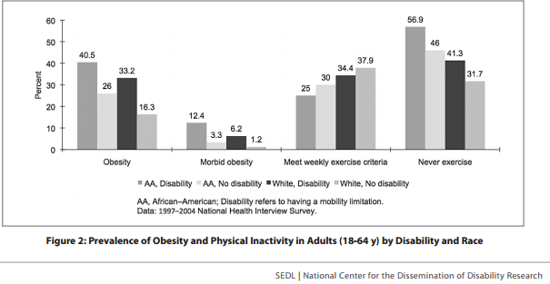
The Arc HealthMeet® Training
The Arc HealthMeet® Training
Including People with Disabilities: Public Health Workforce
Competencies
Chronic Disease
People with disabilities are more likely to experience chronic health conditions such as diabetes and heart disease
There are more health disparities and higher rates of chronic and secondary conditions for ethnic and racial minorities
Source: Rimmer, J. A., Wang, E., Yamaki, K., & Davis, B. (2009). Documenting disparities in obesity and disability. FOCUS Technical Brief (24). Austin, TX: SEDL.
Notes:
PWD More likely to be obese when compared with people without disabilities (37.6% c)
Obesity rates are higher in African Americans with disabilities who have 4 times more risk for obesity and 10 times more risk for morbid obesity than White Americans without disabilities (Rimmer, Wang, Yamaki, and Davis, 2009)
compared to 23.8% of people without disabilities

Slide 15
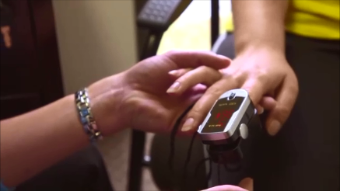
The Arc HealthMeet® Training
The Arc HealthMeet® Training
Including People with Disabilities: Public Health Workforce
Competencies
Chronic Disease and Secondary Conditions
Studies have shown that people with ID are vulnerable to a range of chronic health problems that include:
• sensory problems (including vision, hearing and dental)
• poor nutrition
• constipation
• gastro-esophageal reflux disease (GERD)
• obesity
• osteoporosis
• epilepsy
• cardiovascular disease
• Type 1 and Type 2 diabetes
• some types of cancers (particularly stomach and gall-bladder)
• mental health problems
Source: Centers for Disease Control and Prevention (CDC). (2016). Related Conditions. Retrieved from: http://www.cdc.gov/ncbddd/disabilityandhealth/relatedconditions.html
Notes:
People with disabilities are also at risk for other health conditions called secondary conditions
Secondary conditions can be defined as “any additional physical or mental health condition that occurs as a result of having a primary disabling condition
Facts:
On average people with intellectual disability have more significant health problems and die younger than their non-disabled peers, particularly those in the severe to profound range (Ouellette-Kuntz et al., 2005; Krahn et al., 2006)
People with moderate to severe intellectual disabilities are 3 times as likely to die earlier than the non-disabled population (Turner, 2011)
The next module will discuss health disparities for people with disabilities and emerging issues

Slide 16
The Arc HealthMeet® Training
The Arc HealthMeet® Training
Including People with Disabilities: Public Health Workforce
Competencies
Health Disparities
Health Promotion
and
Including People with Disabilities in Planning

Slide 17
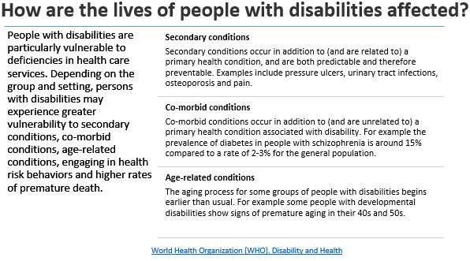
The Arc HealthMeet® Training
The Arc HealthMeet® Training
Including People with Disabilities: Public Health Workforce
Competencies
Health Disparities
There is a disparity in the health outcomes of people with ID and other disabilities as compared to people without disabilities¹
Despite laws like the American’s with Disabilities Act (ADA), many barriers to accessing and participating in healthy lifestyle activities still exist for people with ID
Barriers may include such factors as inaccessible health care facilities or health screening equipment, discriminatory attitudes, and lack of knowledge about people with disabilities or their health care needs
1. Johnson, J., and Woll, J. (2003). A National Disgrace: Health Disparities Encountered by Persons with Disabilities. Disability Studies Quarterly Winter 2003, Volume 23, (1), 61-74. Retrieved from: http://dsq-sds.org/article/view/400/547
Notes:
A "disparity" is defined as difference in quality of health care received by a segment of the population (in comparison with the general population) that is not due to access-related factors or clinical needs, preferences, and appropriateness of interventions. ¹
Lack of knowledge or experience on how to interact and communicate with people with disabilities create barriers to people with ID achieving positive health outcomes.
Consideration of culturally specific differences among people with disabilities, and among subgroups of that population is essential to decreasing health disparities

Slide 18
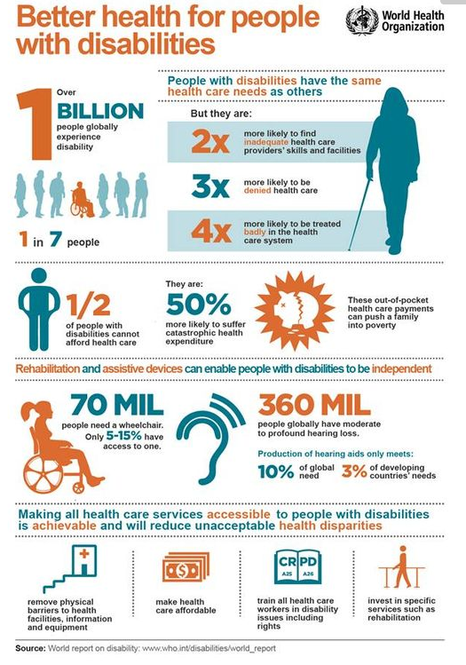
The Arc HealthMeet® Training
The Arc HealthMeet® Training
Including People with Disabilities: Public Health Workforce
Competencies
Other personal barriers to health for people with ID are:
  poverty
  unemployment
  lack of health insurance
  lack of reliable or accessible transportation
  inability for care givers to accompany them to appointments
  low health literacy
  lack of knowledge about healthy lifestyles
  lack of trust in health care providers due to discrimination or unpleasant experiences

Slide 19
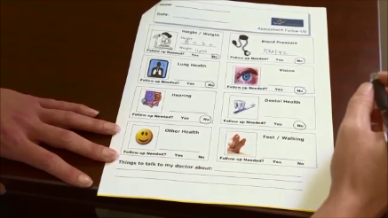
The Arc HealthMeet® Training
The Arc HealthMeet® Training
Including People with Disabilities: Public Health Workforce
Competencies
Health Promotion
State and national data describe disparities in health for people with ID and suggest that having a disability can create risks for other preventable health issues
Similar to the general population, it is critical that individuals with ID are given the information they need to make healthy choices on how to prevent illness
It is also critical that racial & ethnic disparities are acknowledged when providing information to individuals with ID
Notes:
The health of people with disabilities should be relatively comparative to those without disabilities.
As a result of having a disability other physical or mental health conditions can occur.
These health conditions are called secondary conditions, and they can be prevented as well as treated.
These problems can include pain, depression, and a greater risk for certain illnesses such as flu.
Activities such as exercise, smoking cessation, healthy eating, and preventive screenings should be promoted and accessible to all Americans, as there is a range of health benefits for people with and without ID.

Slide 20
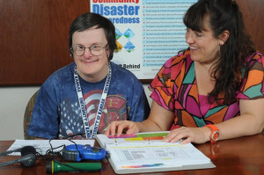
The Arc HealthMeet® Training
The Arc HealthMeet® Training
Including People with Disabilities: Public Health Workforce
Competencies
Including People with Disabilities in Planning
To improve the health of people with ID, the public health community can support the development and implementation of health promotion interventions for people with ID
Inclusive public health programs would more effectively reach underserved populations and promote reduction of health disparities experienced by people with ID ³
People with I/DD can provide feedback on how public health organizations can better explain (written/oral) information so that people with limited reading skills and comprehension can better understand
3. National Center on Birth Defects and Developmental Disabilities (NCBDDD). CDC Promoting the Health of People with Disabilities, NCBDDD Fact Sheet.
Notes:
Many health promotion programs do not consult or include people with ID or other disabilities in their program design
Increased risk for serious health conditions, coupled with existing barriers, underscore the importance of including people with ID and other disabilities in public health efforts
Cultural competence in health promotion programs is also a necessity to ensure systemic racial and ethnic disparities don’t impact the health care of people with ID.

Slide 21
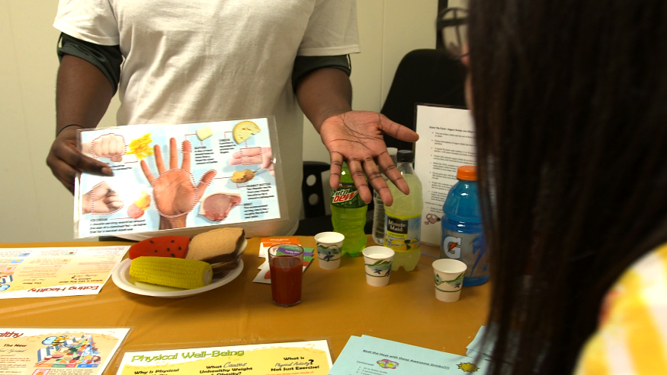
The Arc HealthMeet® Training
The Arc HealthMeet® Training
Including People with Disabilities: Public Health Workforce
Competencies
Inclusion Strategies to Include People with ID/D in Planning
Health Promotion Program Programming Considerations:
Use visual images to communicate program content
Use plain language
Adapt program content to a fourth or fifth-grade reading level (see http://bit.ly/1jibufn )
Provide staffing/volunteers to assist with program implementation
Include caregivers in programming
Source: NACCHO. (2014). Strategies for Successfully Including People with Disabilities in Health Department Programs, Plans, and Services

Slide 22
The Arc HealthMeet® Training
The Arc HealthMeet® Training
Including People with Disabilities: Public Health Workforce
Competencies
Emerging Issues for People with Disabilities

Slide 23


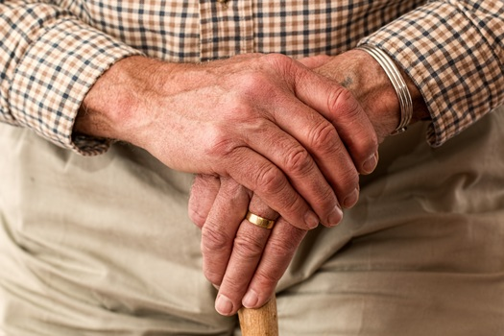

The Arc HealthMeet® Training
The Arc HealthMeet® Training
Including People with Disabilities: Public Health Workforce
Competencies
Emerging Issues for People with Disabilities
Emergency Preparedness
Aging
Preventive Screening
Transportation
Notes:
Despite the great strides toward expanding the rights of people with disabilities, many obstacles still stand in the way of their living fully inclusive lives.
There are many issues to be aware of that impact the lives of people with disabilities.
These emerging issues should be considered when planning public health programs as well as assisting people with disabilities with community resources.

Slide 24
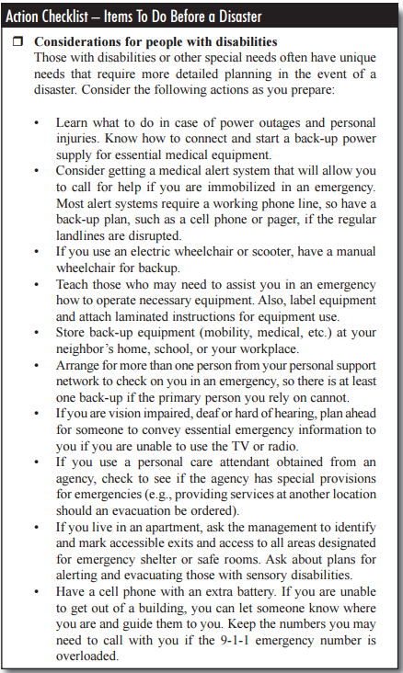
The Arc HealthMeet® Training
The Arc HealthMeet® Training
Including People with Disabilities: Public Health Workforce
Competencies
Emergency Preparedness
People with disabilities will need accommodations during emergencies
Mobility and other challenges (like batteries on wheelchairs/scooters running out of power, not having use of assistive communication devices) for people with disabilities can add difficulty when emergencies arise
Emergency preparedness for people with disabilities that take into account challenges and issues is essential for public safety
Public health professionals can include people with I/DD in emergency preparedness planning to ensure their safety during emergencies
Source: FEMA, American Red Cross. (2004). Preparing for Disaster for People with Disabilities and other Special Needs.

Slide 25
The Arc HealthMeet® Training
The Arc HealthMeet® Training
Including People with Disabilities: Public Health Workforce
Competencies
Aging
Like all of us, the needs of people who have disabilities change as they age
Public health professionals should be aware of the changing healthcare and service needs of people with disabilities as they age so they can create targeted health promotion programs for this population
Notes:
In addition to unique needs, the aging population of people with disabilities also experiences the typical health concerns of the general aging population (Krahn and Fox, 2015).
The increasing lifespan of people with disabilities is putting significant pressure on service delivery systems to accommodate a growing number of older people with disabilities (Krahn and Fox, 2015).
Questions that should be asked when planning include:
Are health screening events accessible to older adults or those with disabilities?
Were older adults with disabilities including in planning programs and health promotion events?
Are materials available in large print or other accessible formats?

Slide 26
The Arc HealthMeet® Training
The Arc HealthMeet® Training
Including People with Disabilities: Public Health Workforce
Competencies
Preventive Screening
People with disabilities have a greater incidence of chronic disease than people without disabilities so there is a greater need for people with disabilities to have access to preventive screenings for chronic health issues
Public health professionals can include people with disabilities in planning for health promotion to make sure that people with disabilities are being included in preventive screenings for chronic diseases like hypertension and diabetes
Notes:
Health care issues greatly impact the lives of people with intellectual and developmental disabilities and their families, as they battle with discrimination, poor quality of care and affordability. This can also be exacerbated by cultural and linguistic differences.
Issues like access and cost may be barriers to preventative screening that public health professionals should be aware of to help decrease health disparities for people with disabilities.
They should also be included programs to prevent the flu and other communicable diseases (for example, flu clinics for vaccinations).
Questions that should be asked when planning include:
Are health screening events accessible to people with mobility issues?
Can people with mobility challenges access the examination tables?
Are materials in plain language, with pictures?

Slide 27
The Arc HealthMeet® Training
The Arc HealthMeet® Training
Including People with Disabilities: Public Health Workforce
Competencies
Transportation
Like all of us, people with disabilities rely on transportation to access employment, education, healthcare, and community life
Transportation services allow individuals with disabilities to live independently within their communities
People with disabilities may have difficulty accessing transportation services
Including people with disabilities in planning can help public health professionals identify these challenges and ways to overcome them so this population has access to health care and services
Notes:
Transportation services allow individuals with disabilities to live independently within their communities
Questions that should be asked when planning include:
Do health events and services need to available in the community since people with disabilities may not have transportation be able to access a clinic?
Can we partner with bus systems to provide free or low cost fare for people to come to our building for their flu shots?
Can we work with volunteer drivers to transport people from home to our clinic?

Slide 28
The Arc HealthMeet® Training
The Arc HealthMeet® Training
Including People with Disabilities: Public Health Workforce
Competencies
Competencies and Learning Objectives

Slide 29
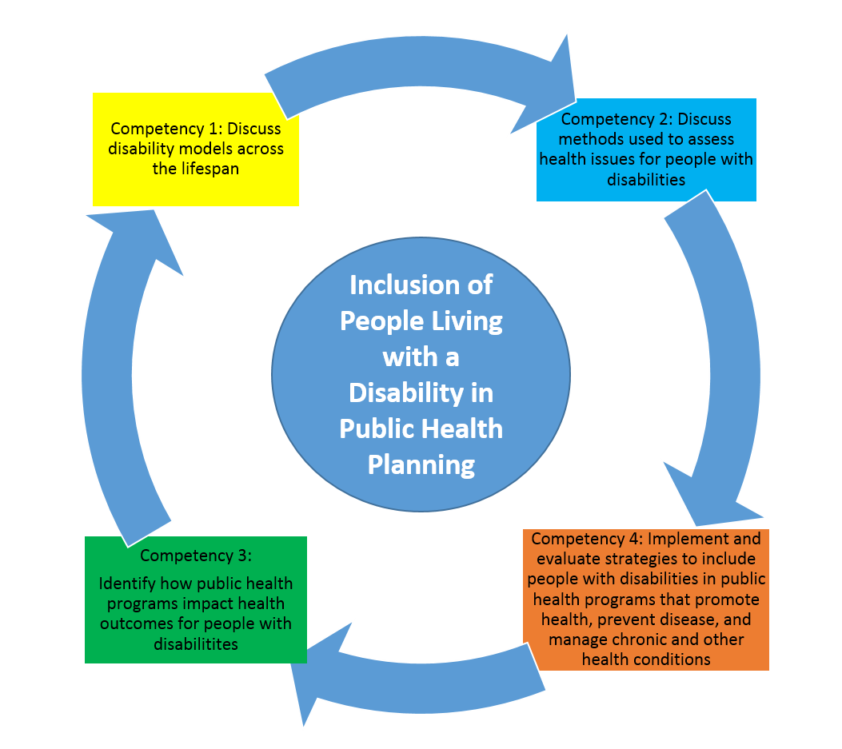
The Arc HealthMeet® Training
The Arc HealthMeet® Training
Including People with Disabilities: Public Health Workforce
Competencies
Notes:
People with ID and other disabilities are at a higher risk for poor health outcomes
The risks are higher for people with disabilities from diverse communities
The four Competencies and associated learning objectives will address the knowledge gaps for public health professionals about disability, and health disparities
They provide foundational knowledge about the relationship between public health programs and health outcomes among people with disabilities
The Competencies can also be embedded into existing public health curriculum and training programs

Slide 30
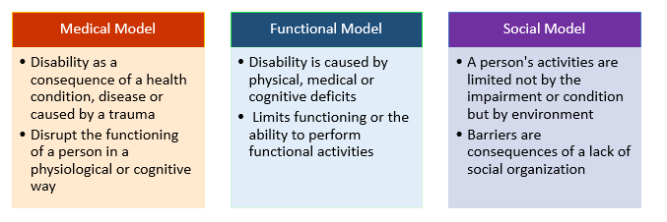
The Arc HealthMeet® Training
The Arc HealthMeet® Training
Including People with Disabilities: Public Health Workforce
Competencies
Competency 1: Discuss disability models across the lifespan
People with disabilities are individuals who have some type of limitation in mobility, cognition, vision, and/or hearing, or have other disorders
Disability is not defined by any specific health condition but whether that condition actually creates significant limitations for an individual affecting their daily lives and functioning
Disability models can be used as guidelines or tools to help define the strengths and limitations associated with disability, and provide a basis for strategies to meet the needs of people with disabilities
Notes:
There are three commonly used models of disability. Having knowledge of these models will help public health professionals more effectively interact with and support people with disabilities, as well as understand the relationship between the disability and people’s everyday lives
No one model can completely describe the disability experience because disability itself is complex and the experiences of people with disabilities will vary widely.
Additional notes:
Black and Latino adults with ID have markedly worse health status than both their white counterparts with ID and nondisabled adults within their racial and ethnic groups.

Slide 31
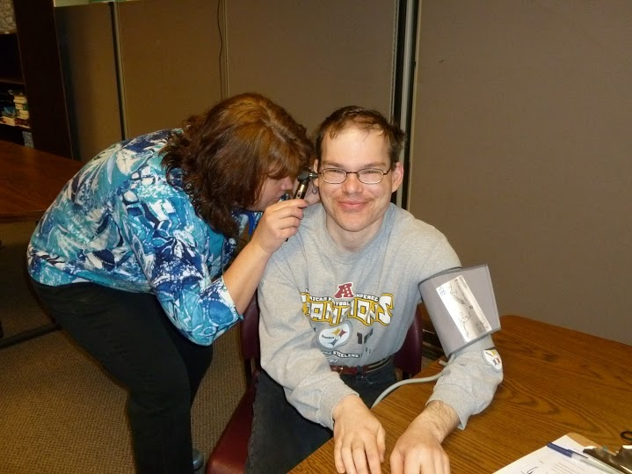
The Arc HealthMeet® Training
The Arc HealthMeet® Training
Including People with Disabilities: Public Health Workforce
Competencies
Learning Objectives
1.1 Compare and contrast different models of disability
1.2. Apply model(s) of disability for a particular scope of work or population served

Slide 32
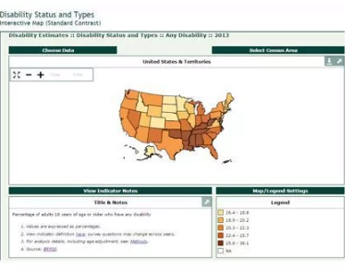
The Arc HealthMeet® Training
The Arc HealthMeet® Training
Including People with Disabilities: Public Health Workforce
Competencies
Competency 2: Discuss methods used to assess health issues for people with disabilities
Having knowledge of methods for public health programs is needed for public health professionals.
This knowledge will help public health professionals with planning programs, examining the operations of a program, and conducting activities that improve health outcomes for people with disabilities.

Slide 33
The Arc HealthMeet® Training
The Arc HealthMeet® Training
Including People with Disabilities: Public Health Workforce
Competencies
Learning Objectives
2.1 Identify surveillance systems used to capture data that includes people with disabilities
2.2. Recognize that disability can be used as a demographic variable
Notes:
Unfortunately there are not a lot of data systems that collect information on disability.
We are not recommending just BRFSS, but this was an example from CDC grantees on how it was used.
If you have some other examples please use them
BRFSS is one of many surveillance systems commonly used to present data on people with disabilities and provide support for funding and sustainability of public health programs.

Slide 34
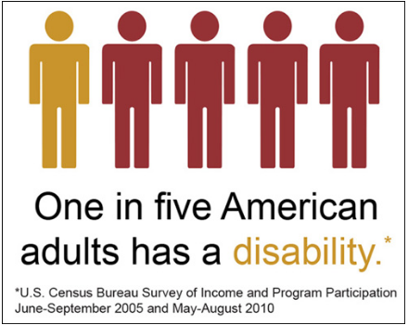
The Arc HealthMeet® Training
The Arc HealthMeet® Training
Including People with Disabilities: Public Health Workforce
Competencies
Competency 3: Identify how public health programs impact health outcomes for people with disabilities
People with ID experience barriers to access health services like:
  inaccessible reading materials
  noisy environments or too much stimulation
  lack of medical staff trained to serve patients with ID
  not feeling comfortable asking professionals questions or lack of self advocacy skills
  lack of health literacy
Brault, Matthew W., “Americans With Disabilities: 2010,” Current Population Reports, P70-131, U.S. Census Bureau, Washington, DC, 2012. http://www.census.gov/prod/2012pubs/p70-131.pdf;
Notes:
Over 56.7 million Americans have a disability, making up about 19% of the American population.
About 1-3 % of the adult U.S. population has ID
This means that people with disabilities are a large part of the communities that public health professionals serve.
People with disabilities experience more chronic health problems than the general population; this can be complicated by race and ethnicity.
People with ID have the right to be able to access and interact with their environment without barriers, and receive health interventions and services just like the general population

Slide 35
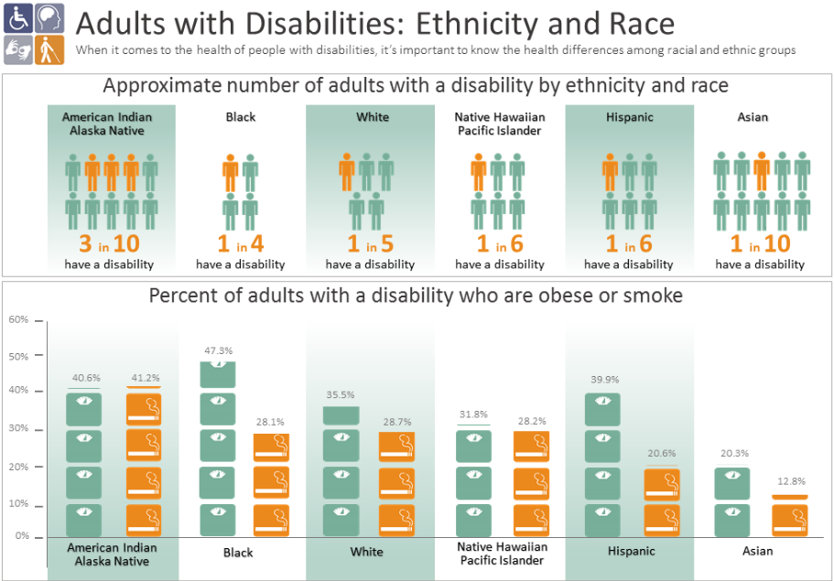
The Arc HealthMeet® Training
The Arc HealthMeet® Training
Including People with Disabilities: Public Health Workforce
Competencies
Considering race and ethnicity can support the success of health promotion outreach
Source: CDC. (2016). Disability and Health. Key Findings: Socioeconomic Factors at the Intersection of Race and Ethnicity Influencing Health Risks for People with Disabilities
http://www.cdc.gov/ncbddd/disabilityandhealth/features/kf-socioeconomic.html
Notes:
This competency will help provide awareness for public health professionals that
Disability is a part of the human experience
A focus of public health should be the promotion of health to people with ID and other disabilities, and the identification and reduction of health disparities of a diverse community of people with disabilities
Public health organizations and professionals should always include people with disabilities in health promotion and planning efforts to help reduce health disparities as well as improve the health outcomes of people with disabilities

Slide 36
The Arc HealthMeet® Training
The Arc HealthMeet® Training
Including People with Disabilities: Public Health Workforce
Competencies
Learning Objectives
3.1. Recognize health issues of people with disabilities and health promotion strategies that can be used to address them
3.1. Recognize health issues of people with disabilities and health promotion strategies that can be used to address them
3.2. Use laws as a tool to support people with disabilities
3.3. Recognize accessibility standards, universal design, and principles of built environment that affect the health and quality of life for people with disabilities
3.4. Explain how public health services, governmental programs, and non-governmental/ community-based organizations interact with disability
3.5. Describe how communities (places where people live, work, and recreate) can adapt to be fully inclusive of disability populations

Slide 37
The Arc HealthMeet® Training
The Arc HealthMeet® Training
Including People with Disabilities: Public Health Workforce
Competencies
Competency 4: Implement and evaluate strategies to include people with disabilities in public health programs that promote health, prevent disease, and manage chronic and other health conditions
Having access to health promotion and preventative services is essential for people with ID for improved health outcomes
People with ID should be included in health promotion efforts and disease prevention and management
In order for professionals to understand the needs of people with ID and other disabilities, they need to partner with them in public health efforts
Notes:
This competency will help professionals to have foundational knowledge on program planning and health promotion that included people with disabilities from all cultural backgrounds

Slide 38
The Arc HealthMeet® Training
The Arc HealthMeet® Training
Including People with Disabilities: Public Health Workforce
Competencies
Learning Objectives
4.1 Describe factors that affect health care access for people with disabilities
4.2. Describe strategies to integrate people with disabilities into health promotion programs
4.3. Identify emerging issues that impact people with disabilities
4.4. Define how environment can impact health outcomes for people with disabilities
4.5. Apply evaluation strategies (needs assessment, process evaluation, and program evaluation) that can be used to demonstrate impact for people with disabilities

Slide 39
The Arc HealthMeet® Training
The Arc HealthMeet® Training
Including People with Disabilities: Public Health Workforce
Competencies
Strategies for Implementation
What are some existing strategies and examples public health professional's can use to implement the Competencies?
Notes:
The following slides include strategies and examples of inclusive state and local health department programs
These strategies and examples will help you take action in a meaningful way now

Slide 40
The Arc HealthMeet® Training
The Arc HealthMeet® Training
Including People with Disabilities: Public Health Workforce
Competencies
Strategy 1. Identify policy changes to include people with disabilities in public health efforts (Competencies 3.2, 4.2)
Action Example: New York State Department of Health (NYSDOH)
Notes:
Programs designed to be inclusive at the outset expand reach, ensure accessibility and are more cost effective than retrofitting or modifying inaccessible programs
Adults with disabilities in New York are 35% more likely to characterize their health as fair or poor compared with adult New Yorkers without disabilities
New York State (NYS) also has the highest disability-associated health expenditures of any state in the country—more than $40 billion
The Disability and Health Program (DHP) within the New York State Department of Health (NYSDOH) initiated a policy change to ensure public health programs are integrating the needs of people with disabilities into initiatives
The DHP worked with the CCH to integrate disability components into a variety of public health programs, including tobacco cessation, food security, adolescent pregnancy prevention, and obesity prevention

Slide 41
The Arc HealthMeet® Training
The Arc HealthMeet® Training
Including People with Disabilities: Public Health Workforce
Competencies
Strategy 2. Identify health promotion strategies that can be used to address the health issues of people with disabilities (Competencies 4.2, 4.3)
Action Example: Montana Living Well with a Disability Program and Disability and Health Program
Notes:
An example of health promotion activities for people with disabilities is the Montana Living Well with a Disability Program
The program is designed to help people with a disability strengthen existing skills to live well
The program includes a workshop comprised of eight, two hour sessions that introduce a process for setting and clarifying goals, as well as teaching skills for generating, implementing, and monitoring solutions
Participants in the program learn the life skills they need to set and achieve quality-of-life goals and the important role health plays in helping them reach their dreams including:
getting a job, going back to school, or leading a more active social life
Increased awareness of disability rights/advocacy

Slide 42
The Arc HealthMeet® Training
The Arc HealthMeet® Training
Including People with Disabilities: Public Health Workforce
Competencies
Strategy 3. Recognize accessibility issues that may affect the health and quality of life for people with disabilities (Competencies 3.5, 4.1, 4.3, 4.4)
Action Example: The South Carolina Interagency Office of Disability and Health
Notes:
(SCIODH) The South Carolina Interagency Office of Disability and Health (SCIODH) partnered with the S.C. Office of Rural Health, and the Centers for Disease Control and Prevention’s (CDC) breast and cervical cancer program, Best Chance Network, to conduct an accessibility assessment of facilities, educate facility staff on how to provide equitable services, and acquired funding for facility modifications
Response has been positive with all 46 counties in South Carolina having been assessed with specific modification recommendations for medical facilities for American Disabilities Act (ADA) compliance
Modifications include: designated accessible parking, constructed accessible entries including ramps and front doors, modified restrooms for complete accessibility, purchased wheelchair accessible scales, and purchased adjustable height exam tables

Slide 43
The Arc HealthMeet® Training
The Arc HealthMeet® Training
Including People with Disabilities: Public Health Workforce
Competencies
Strategy 4. Recruit people with disabilities from local communities to participate in an advisory capacity (Competency 4.2)
Action Example: The Kansas Disability and Health Program
Notes:
The Kansas Disability and Health Program (DHP) recruited Kansans with disabilities to participate in state-level public health advisory councils
These participants comprise the DHP Advisory Board
The Advisory Board met with chronic disease managers to address health care barriers for people with disabilities
Barriers included: Poor access to health care that forces many to go without regular visits to health care providers, and unfair treatment by their physician or office staff because of their disability
Together they created an online continuing education course on disability and health for health care professionals
By involving people with disabilities as part of their Advisory Board, DPH hopes all of their programs will reflect different perspectives and personal experiences with disability, and better address the needs of people with disabilities in the community

Slide 44
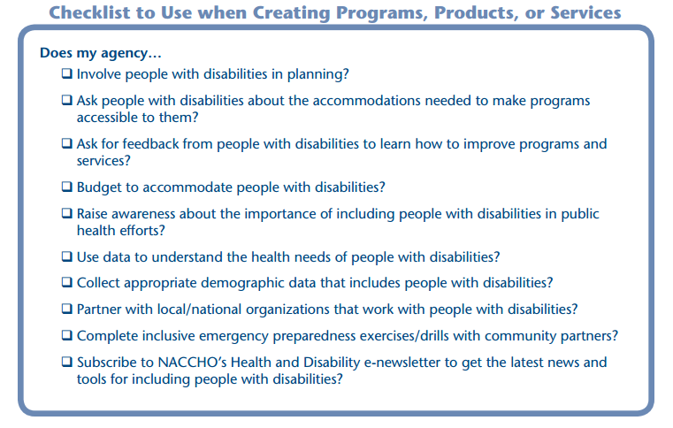
The Arc HealthMeet® Training
The Arc HealthMeet® Training
Including People with Disabilities: Public Health Workforce
Competencies
Strategy 5. Support the inclusion of people living with disabilities in your local public health practice (Competencies 1.2, 3.2, 3.4, 4.5)
Action Example: the National Association of County and City Health Officials (NACCHO)
Source: Strategies for Successfully Including People with Disabilities in Health Department Programs, Plans, and Services. NACCHO
Notes:
To help Local Health Departments (LHD’s) successfully include people with disabilities in their public health practice, NACCHO developed Strategies for Successfully Including People with Disabilities in Health Department Programs, Plans, and Services
This resource provides a disability inclusion checklist and a detailed list of strategies that LHDs can implement to become more inclusive of people with disabilities in health promotion programming and emergency preparedness planning

Slide 45
The Arc HealthMeet® Training
The Arc HealthMeet® Training
Including People with Disabilities: Public Health Workforce
Competencies
Strategies – Take Away
Identify key and non traditional partners at various levels
  What are some organizations and groups you could partner with?
  What are some non traditional partnerships?
Connect and Network
  Reach out to a contact in your community
  Ask about their partners, and other resources
  Reach out to people with disabilities
  Don’t forget caregivers

Slide 46
The Arc HealthMeet® Training
The Arc HealthMeet® Training
Including People with Disabilities: Public Health Workforce
Competencies
Call to Action:
Include people with disabilities in public health program planning and design

Slide 47
The Arc HealthMeet® Training
The Arc HealthMeet® Training
Including People with Disabilities: Public Health Workforce
Competencies
How:
Identify a program, health promotion event, or community need
Seek out creative partnerships
Talk with people with disabilities and caregivers
Use the NACCHO Checklist
Review modules 1-3 for resources on communication for people with disabilities, cultural competence, and more
Use the Competencies website and resources

Slide 48
The Arc HealthMeet® Training
The Arc HealthMeet® Training
Including People with Disabilities: Public Health Workforce
Competencies
For more resources, strategies add examples visit:
www.DisabilityinPublicHealth.org
If you have questions or strategies, examples you want to share:
Email: DisabilityinPH@aucd.org
Join our LinkedIn Group:
Including People with Disabilities: Public Health Workforce Competencies
Follow us on Twitter:
@PHis4Everyone #DisabilityinPH

Slide 49
The Arc HealthMeet® Training
The Arc HealthMeet® Training
Including People with Disabilities: Public Health Workforce
Competencies
Thank You

